Slide 2
Agenda
In this session you able to see and do the whitelisting on SANDVINE Platform.
Also, you will able to identify the APN level whitelisting or the number level whitelisting.

Slide 3
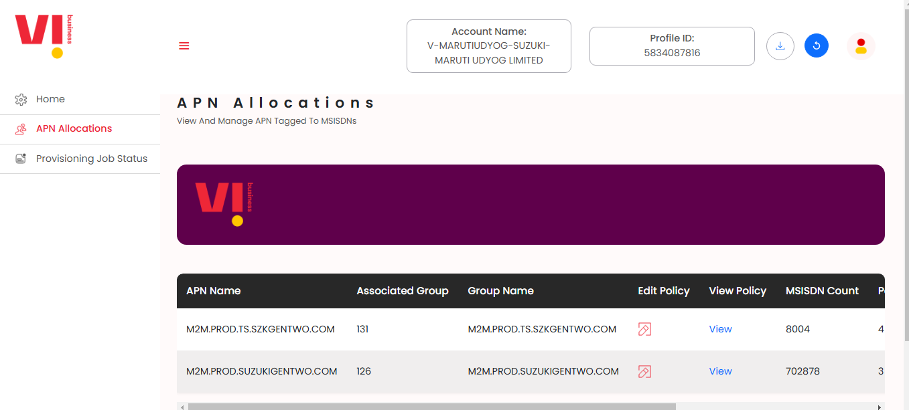
SANDVINE Home Page
If Customer is having APN base whitelisting, then this is the interface you will able to see on the HOME Page of whitelisting.
You can see there are 2 APN.
Which group is associated to the APN
Group Name of the APN
If wants to edit the policy can be done by edit policy
What are the policy
How many numbers are present in the group with particular APN
1
2
3
4
5
6
7

Slide 4
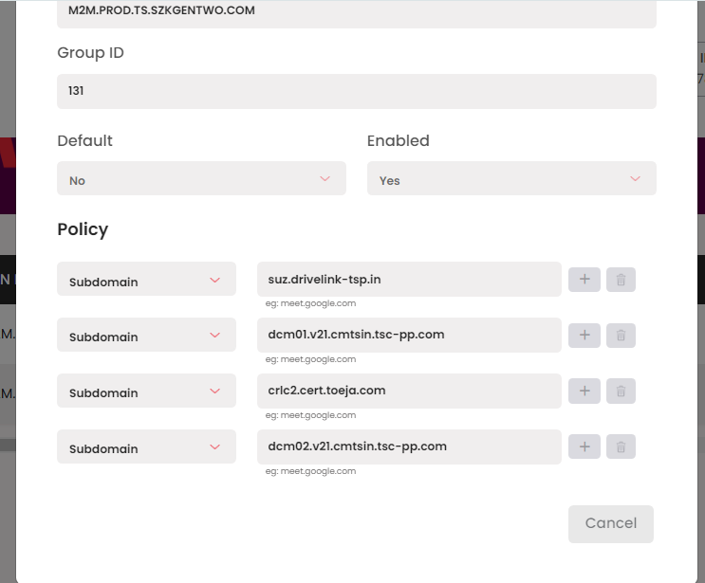
View Policy
1
2
APN Name
Group ID of APN
Default- For any of the new on boarded number- this APN and group will be same.
Enabled
Which protocol need to use for whitelisting
IP/URL/Domain/Application name/ID
You can add new IP/URL with + icon and can delete is not required.
4
3
6
5
7

Slide 5
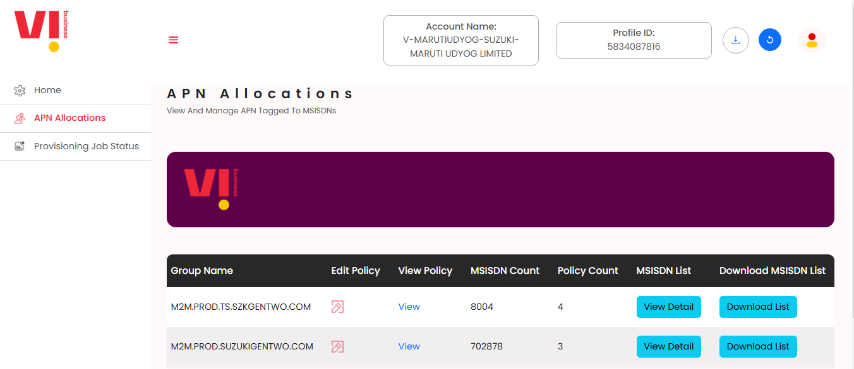
APN Allocations
How much IP/URL are whitelisting in the group is policy count
Which are the MSISDN present in the group
You can download the List of MSISDN
1
2
3

Slide 6
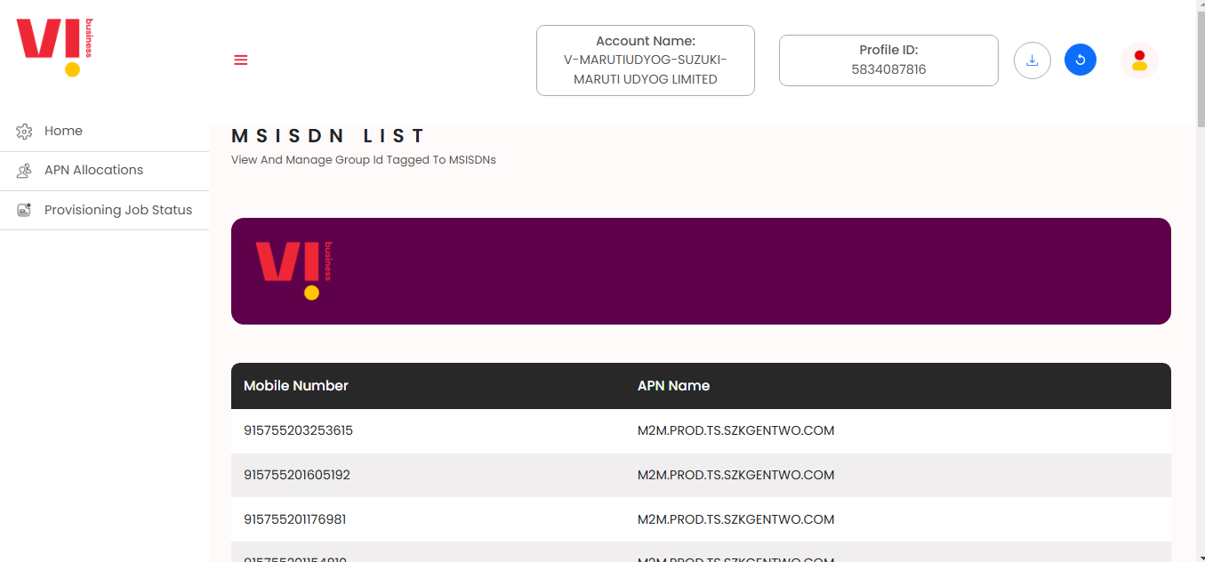
MSISDN List
1. You will able see the List of MSISDN number with APN name
1

Slide 7
Download List
1

Slide 8
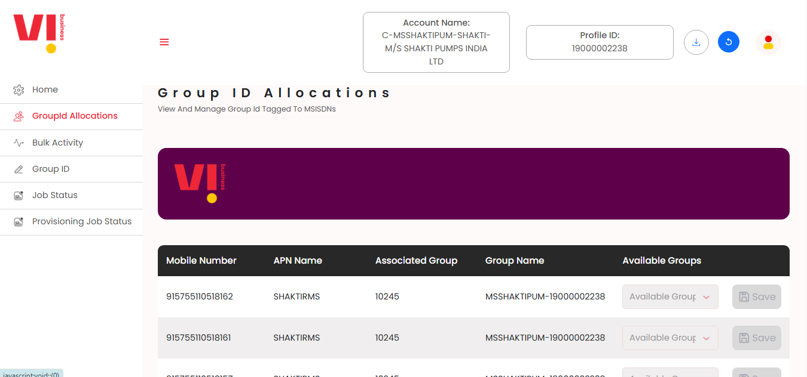
MSISN Based Allocation
1
In Group ID Allocation- There will be MSISDN based whitelisting.

Slide 9
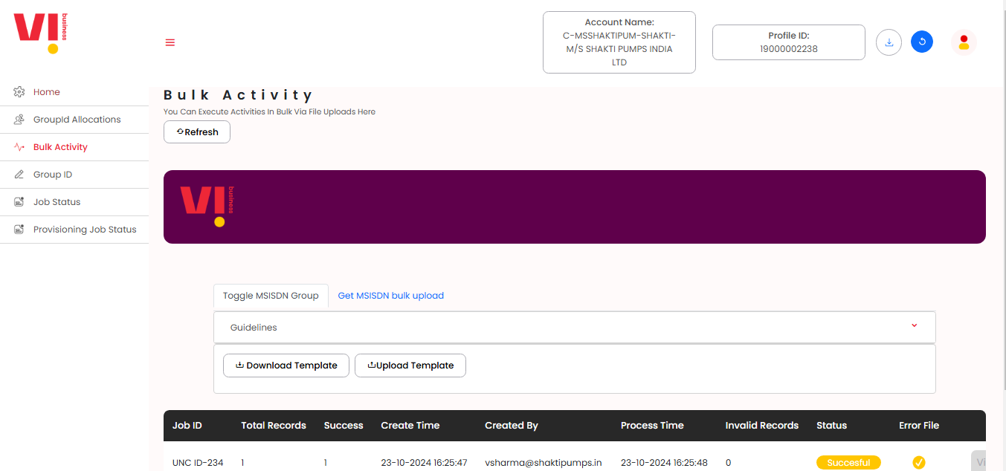
Bulk Activity
Bulk Activity is use to download the All base of numbers also it for doing any whitelisting modification.
From Download Template option you will able to download all the base of the customer.
For any modification Upload Template will be use full
1
2
3

Slide 10
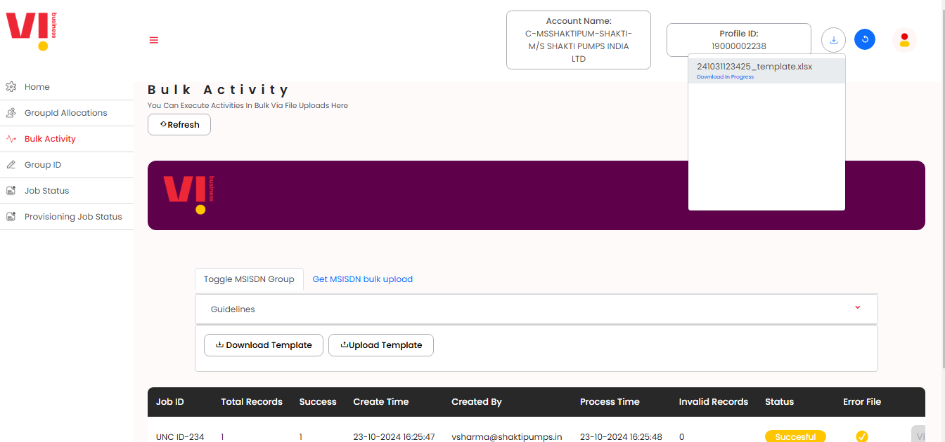

1
1.Download the template will we visible in download section.

Slide 11
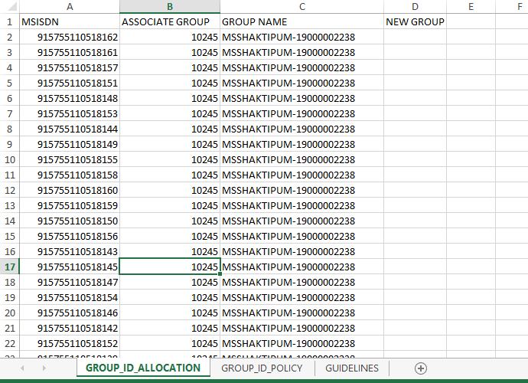
Base of the Customer
2
1
Downloaded file will content whole data base of the customer.
In this file you will able to see the group against the number.

Slide 12
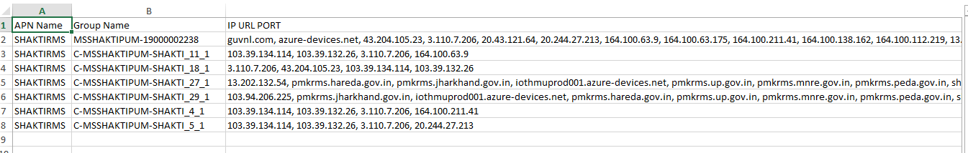
Group of the customer
1
2
Group Name and the IP/URL in the group

Slide 13
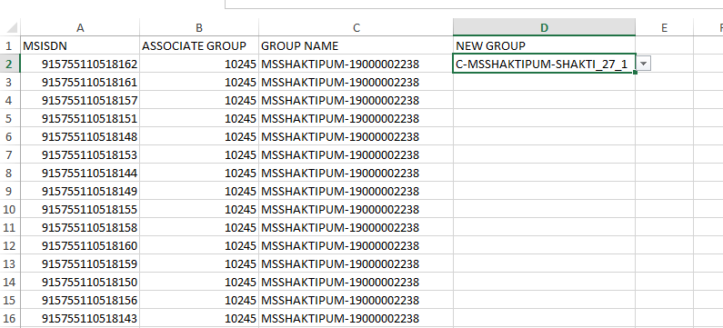
For Modification
1
For changing numbers group you need to select the required group in new group name.

Slide 14
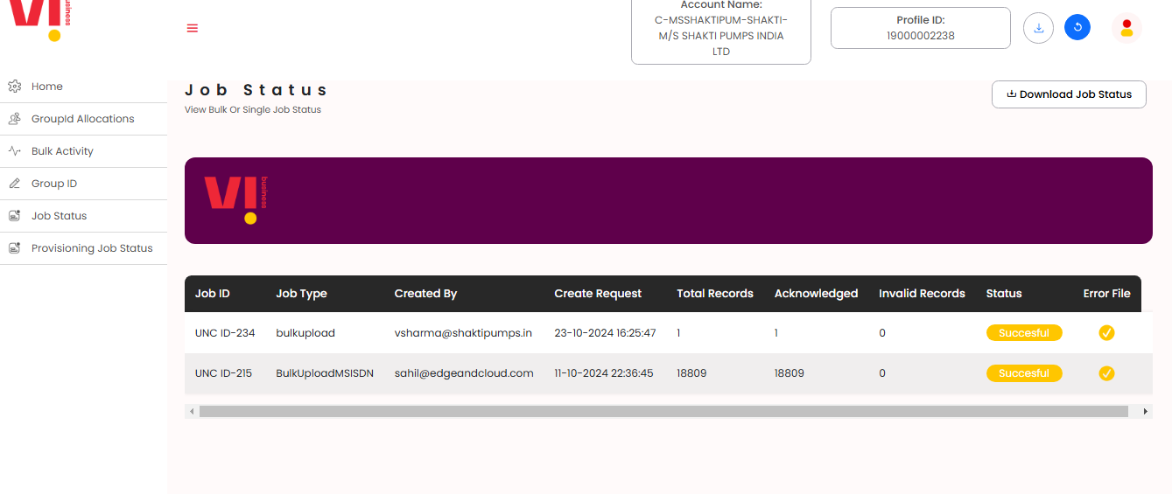
Job Status
Any Modification file status will be visible with the status
1

Slide 15
Thank You!

